Slide 1
TRUE MED
TEAM ELITE:
Santosh Sibyala
Kiran Dwaram
Venkat Kotu
Sreenivas Joga

Slide 2
Our Application
We have built a search engine to help people search for generic medicines or cheaper branded substitutes of the medicines.
We make people more aware about generic drugs.
We provide cheapest medicine recommendations to the users , so that they may probably ask their doctor next time to prescribe generic drugs.

Slide 3
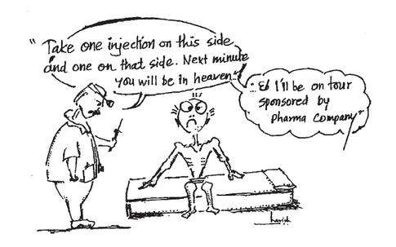
Problem Statement
8 out of 10 prescriptions in INDIA are not using generic medicines. Where INDIA is the largest exporter of generic Medicines.
Even in 2014, people are dying due of lack of access to inexpensive medicines.

Slide 4
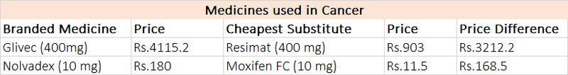
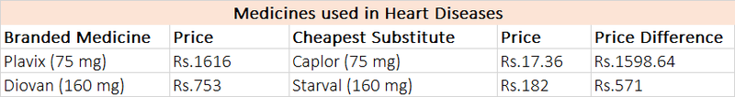
Our Solution
We recommend Generic Medicines to the end-users.
Generic medicines are the medicines which are sold by salt name (constituents) of the medicine. They are exactly same in terms of active ingredients, quality, performance and risk as that of branded medicines, but are much, much cheaper (some as much as 1000 times !).

Slide 5
Data We Used
We got data from True MD API.
We wrote python script to fetch 1 million of records from True MD API.
We got information about manufactures of medicines, cost of the medicines, constituents of medicines and metrics.
For Fact table we have generated 15 millions of records.

Slide 6
Data Model
Our Data Model includes
1. ER Data Model
2. Analytical Data Model
Requirements:
Manufacturer manufactures medicines. Manufacturer has the details like manufacturer_name, address, phone numbers and manufacturer_id. The address of the manufacturer contains information about street, city, state, zip code, country.
Medicine has attributes like medicine_id, generic_id, brand(Cetricon (10 mg)) and calculated percent cheaper.The brand of medicine consists of name,quantity and type.Each medicine has unique generic_id using which it can identify its constituents.
Consists of 1:1 , 1:M , M:M relations
Have all CRUD operations.

Slide 7
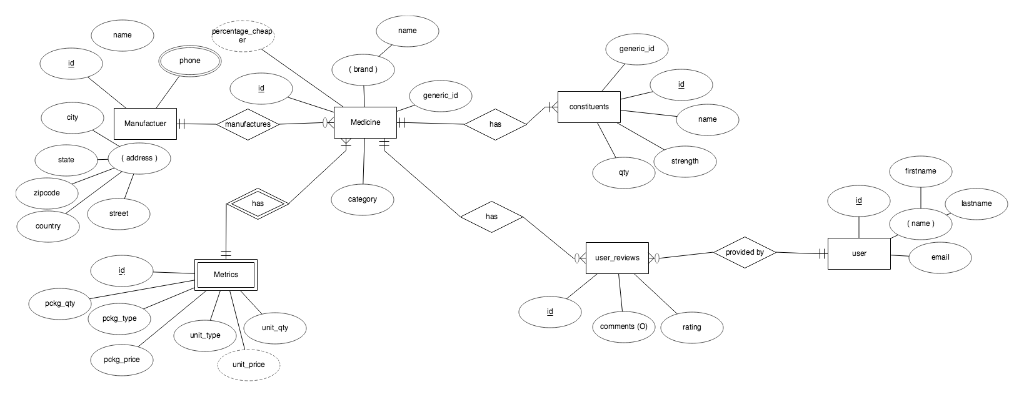
ER Diagram

Slide 8
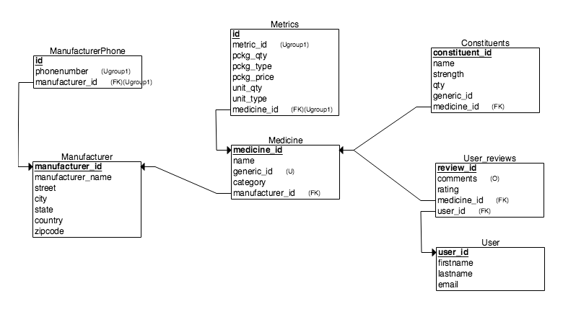
Relational Schemas

Slide 9
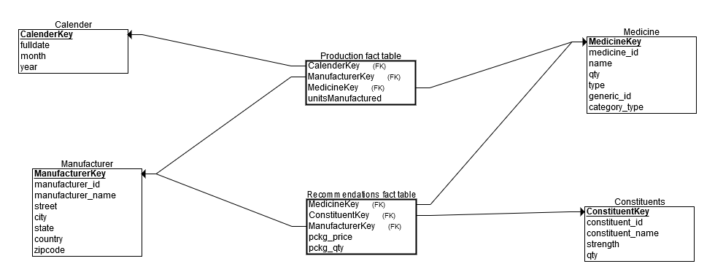
Star Schema

Slide 10
Technology Stack
Apache
PHP/Python
MySQL
HTML/CSS
JavaScript/JQuery
CIS

Slide 11

Lets see the Demo ☺

